Slide 1


Brian Heits
Principle Consultant – Oracle Cerner
4th of December, 2023
Notes:
© Cerner 2016

Slide 2
FHIR Deep Dive

Slide 3
Getting Started: HL7 Community

Slide 4
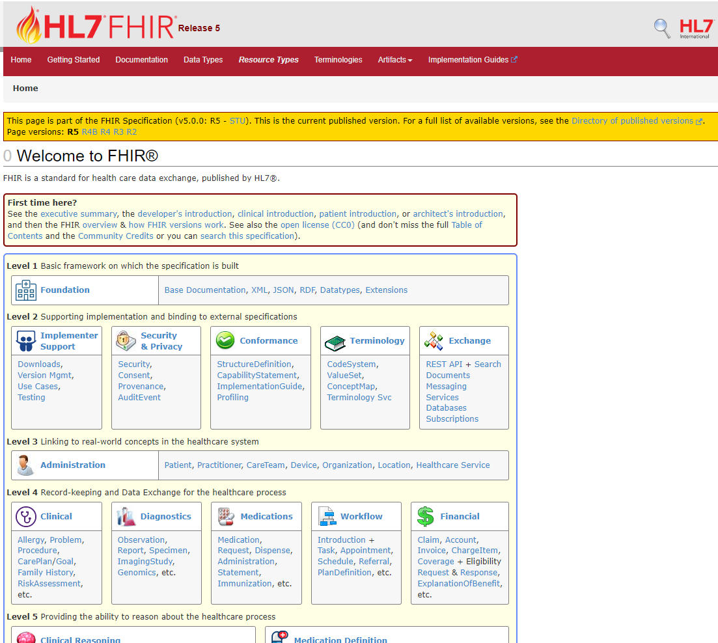



Versioning
Everything Else
Introductions
Note: HAPI is the recommended Java Reference implementation
http://hapifhir.io/index.html
http://hl7.org/fhir/index.html

Slide 5
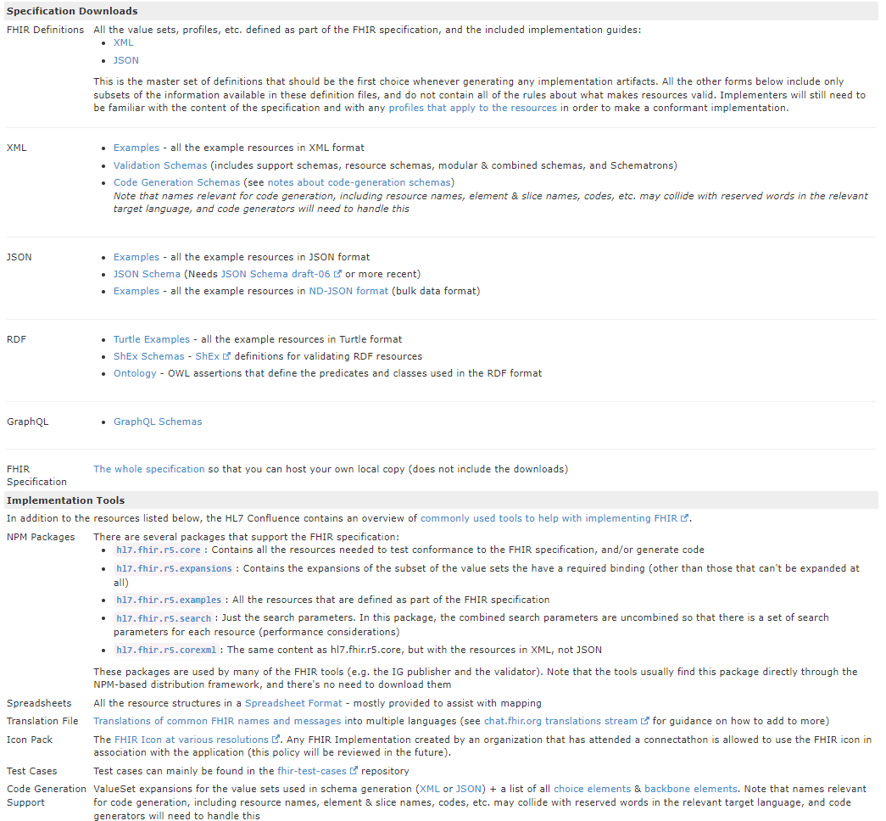
http://hl7.org/fhir/downloads.html

Slide 6
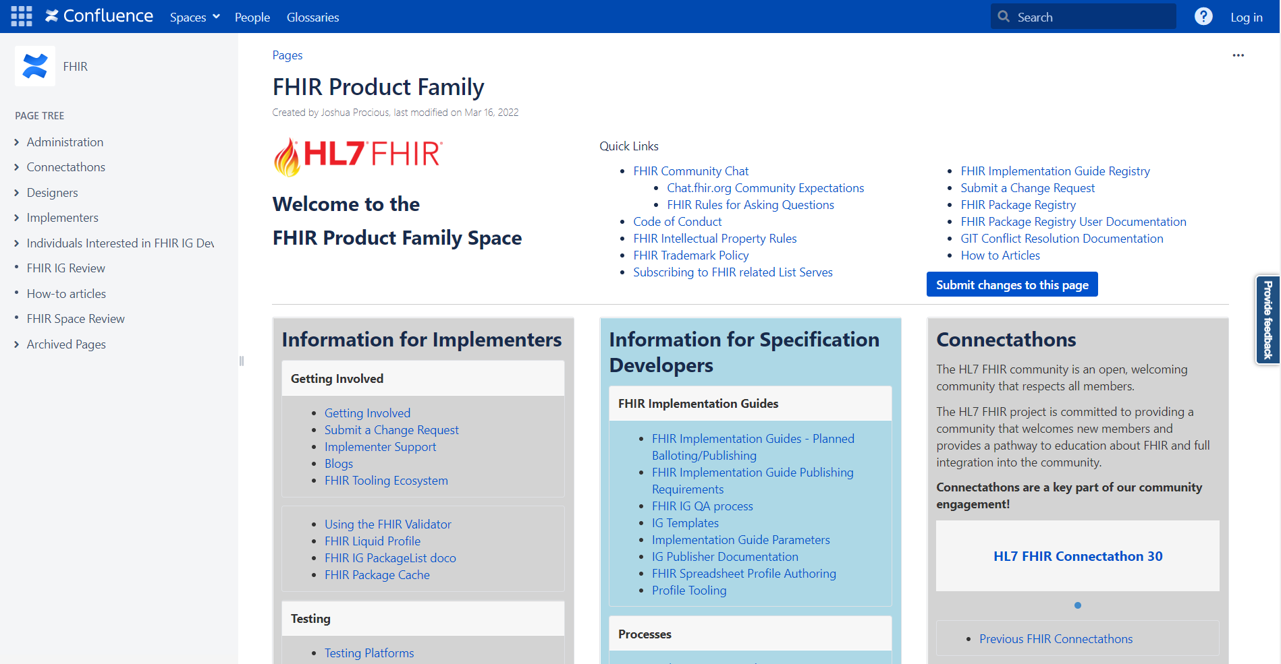
Support
https://confluence.hl7.org/display/FHIR
Notes:
Help getting started

Slide 7
Specification Versioning

Slide 8
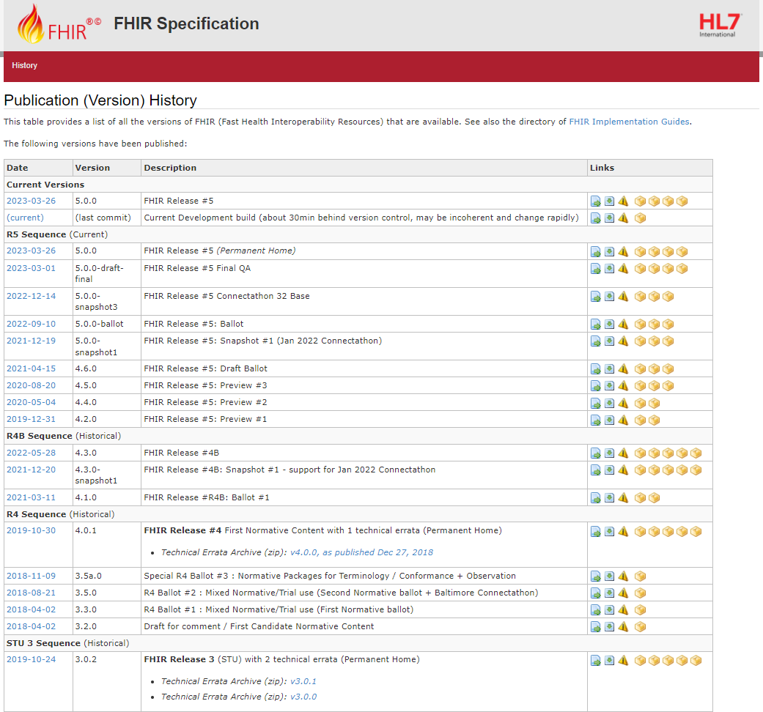
Current: R5 Sequence
AKA: 5.0.0
http://hl7.org/fhir/directory.html

Slide 9
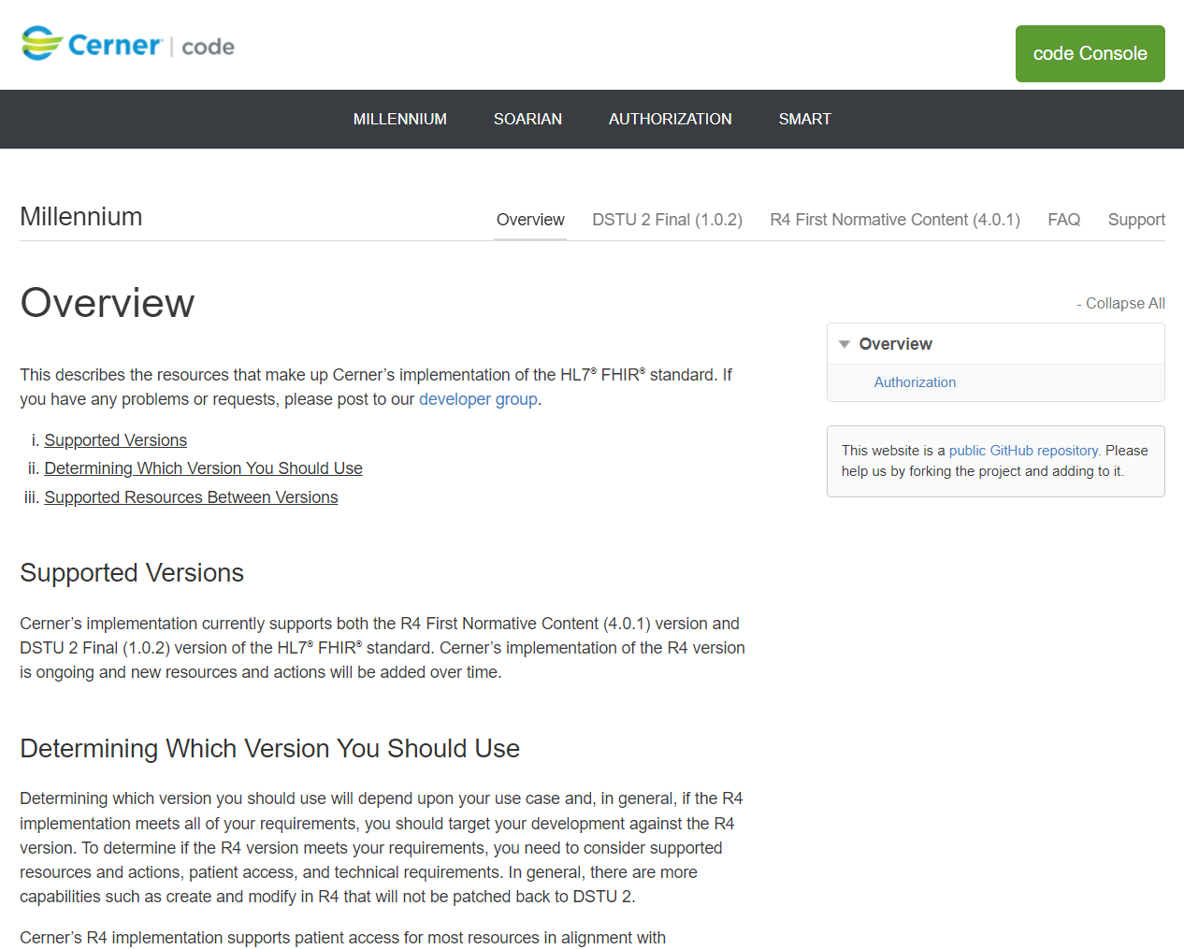
Latest Millennium Production: R4/4.0.1
https://fhir.cerner.com/millennium/overview/

Slide 10

Which Version?
Multiple Available
Deprecate Oldest
Time to Uplift Applications

Slide 11
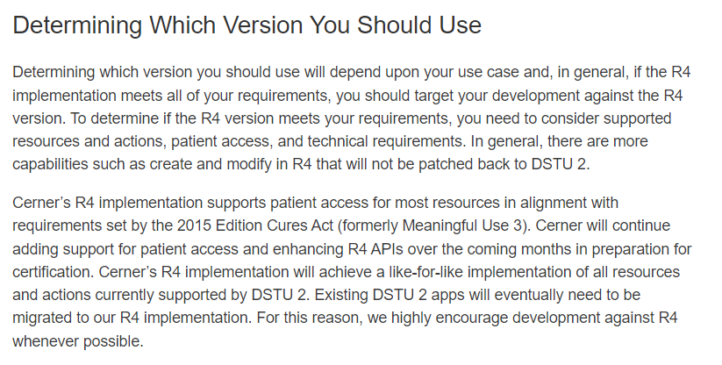
Latest Millennium Production: R4/4.0.1
https://fhir.cerner.com/millennium/overview/

Slide 12
Data Types

Slide 13
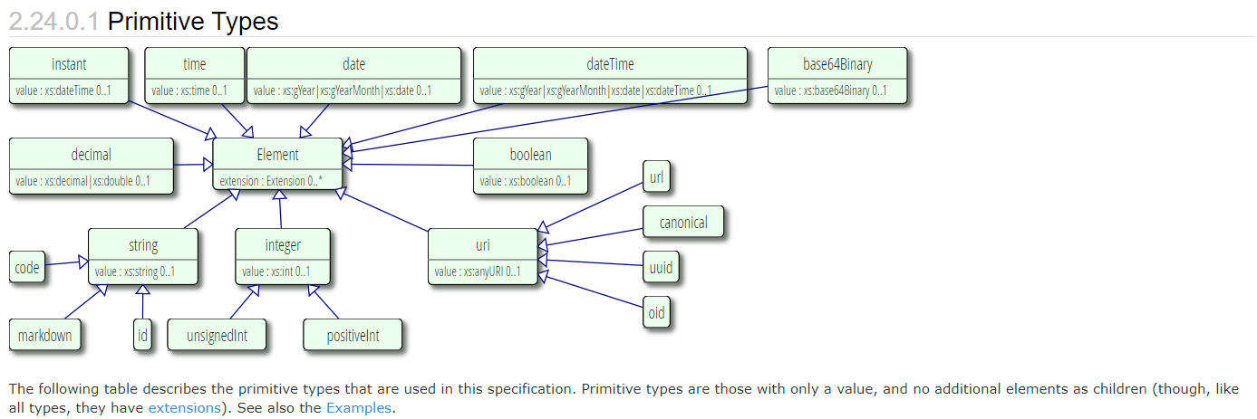
Primitive Types
http://hl7.org/fhir/datatypes.html#primitive

Slide 14
Surprises
Decimal: 1.01, 1.010
Instant vs DateTime
DateTime vs Date vs Time
Notes:
Decimals, precision matters (e.g.: use big decimal)
Instant is for machines, DateTime is for humans. Instant MUST have seconds and zone.
DateTime is year, year/month, year/month/day, year/month/day/time (must have zone if there’s a time). Seconds are required (XML definition/schema), but can be ignored or zero.
Date is year, year/month, year/month/day
Time is zone-less, dateless (see you at 8:00 AM every day)

Slide 15
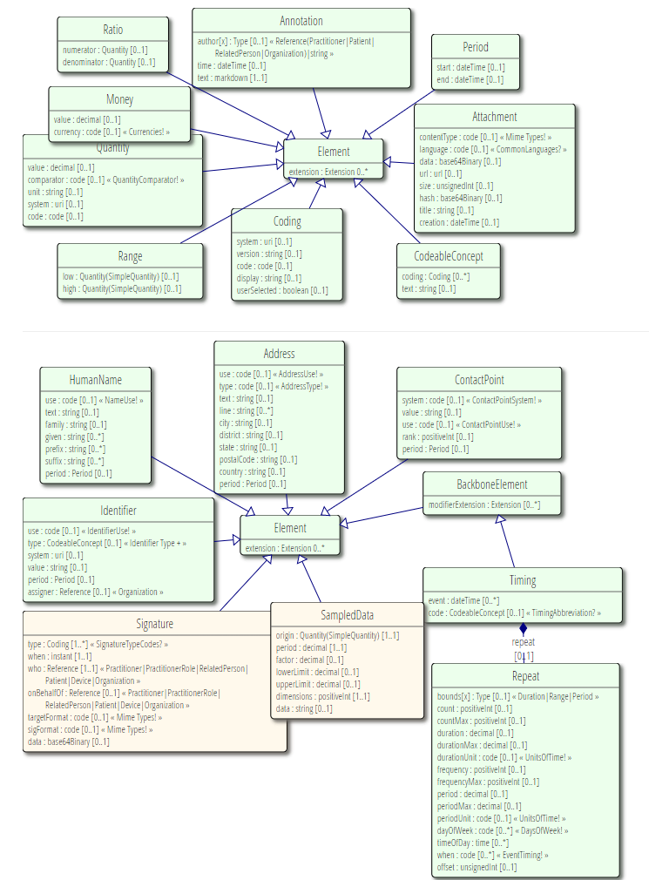
Complex Types
http://hl7.org/fhir/datatypes.html#complex

Slide 16
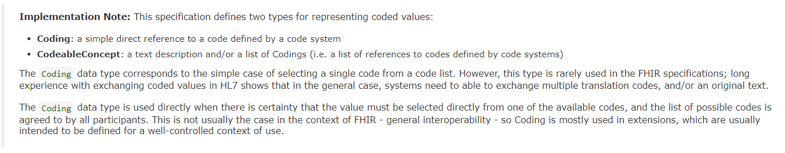
Code Systems
http://hl7.org/fhir/datatypes.html#codesystem
Notes:
Code: codified value (usually from a set of values) to represent a concept.
Coding: Code + meta data (e.g., system, version)
CodeableConcept allows you to choose a list of codes, e.g.: multiple terminologies
CodeableConcept references Coding, Coding references a Code.
Code: m, f, unk
Coding: m, + system
CodeableConcept: Relationship type for patient contacts, Observation type (e.g.: height/weight, Loinc, SNOMED)

Slide 17
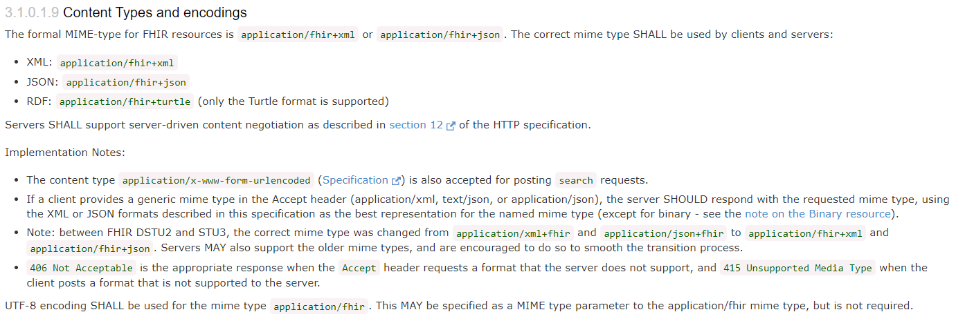
Formats
JSON, XML, or RDF
Via Accept or Content-Type headers
Via _format parameter
https://hl7.org/fhir/http.html#mime-type

Slide 18
Resources

Slide 19
Resources
Patient, Condition, MedicationRequest…
All resources have metadata
All resources have narrative
Structured data items
[base]/[Resource] (case sensitive)
[base]/Patient
https://hl7.org/fhir/resource.html

Slide 20
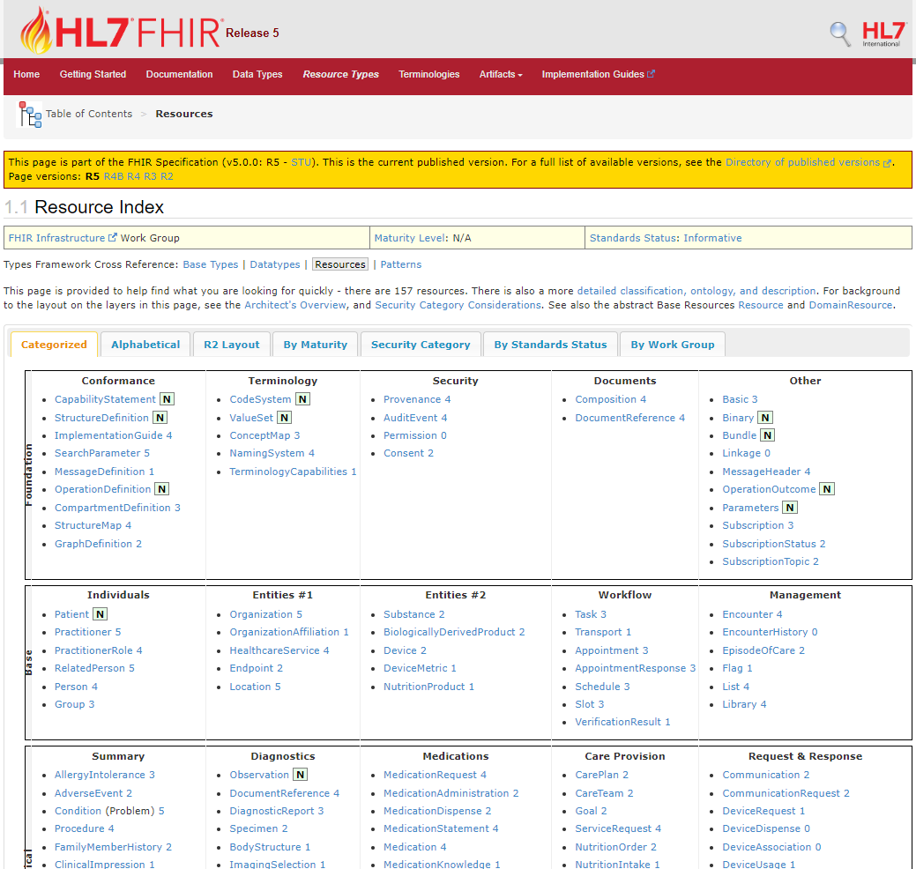
http://hl7.org/fhir/resourcelist.html
Notes:
That number to the side…?

Slide 21
Maturity Levels
Risk for change
Lower number, highest risk
0-5 or (N)ormative
https://hl7.org/fhir/versions.html#maturity
Notes:
If you are adverse to change, choose 4+
… which doesn’t exist in DSTU 2

Slide 22
Terminology Bindings

Slide 23
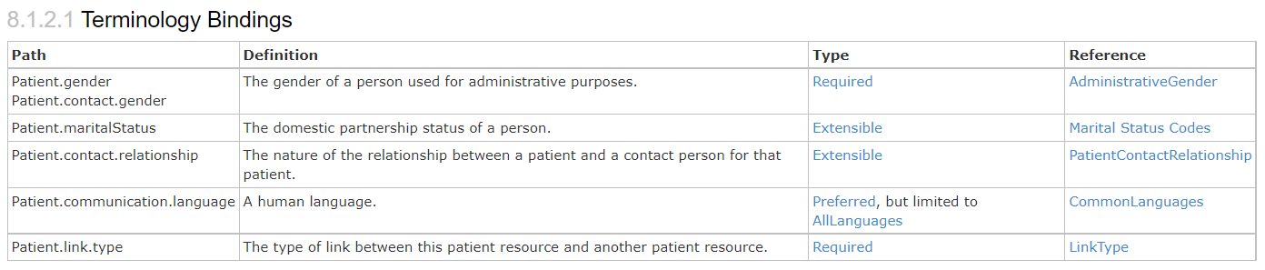
Terminology Bindings
https://hl7.org/fhir/patient.html#tx

Slide 24
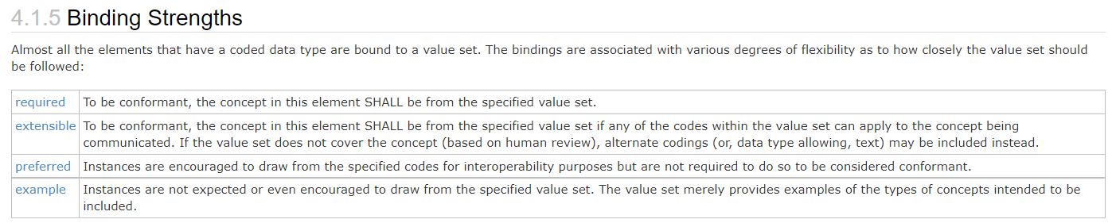
Type/Binding Strength
https://hl7.org/fhir/terminologies.html#strength
Notes:
Required: for codeableConcept, you can’t just send “text”

Slide 25
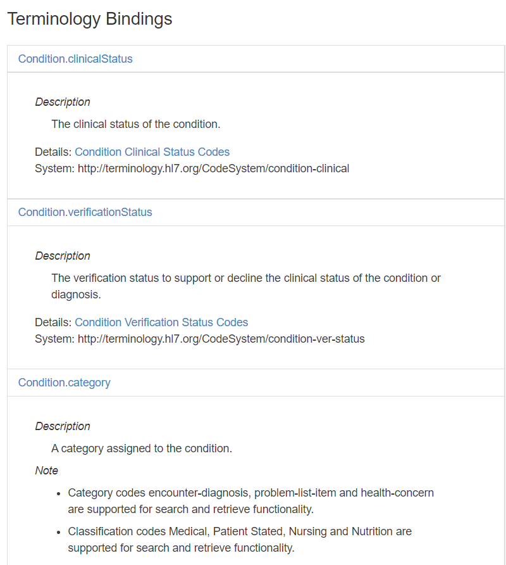
https://fhir.cerner.com/millennium/r4/clinical/summary/condition/#terminology-bindings
Notes:
If a binding isn’t “required” by core spec, we’ll call out what our binding strength is in documentation

Slide 26
Narrative

Slide 27
“Any resource that is a domain resource (almost all types of resource) may include a human-readable narrative that contains a summary of the resource, and may be used to represent the content of the resource to a human. If narrative is present, it SHALL reflect all content needed for a human to understand the essential clinical and business information otherwise encoded within the resource. Resource definitions may define what content should be represented in the narrative to ensure clinical safety.”
https://hl7.org/fhir/narrative.html#Narrative
Notes:
It is often the fall back if a client application doesn’t understand the FHIR resource in question

Slide 28
…”text”: {
"status": "generated",
"div": "<div><table><tbody><tr><td>Name</td><td>Peter James <b>Chalmers</b> (&quot;Jim&quot;)</td></tr><tr><td>Address</td><td>534 Erewhon, Pleasantville, Vic, 3999</td></tr><tr><td>Contacts</td><td>Home: unknown. Work: (03) 5555 6473</td></tr><tr><td>Id</td><td>MRN: 12345 (Acme Healthcare)</td></tr></tbody></table></div>"
}…

Slide 29
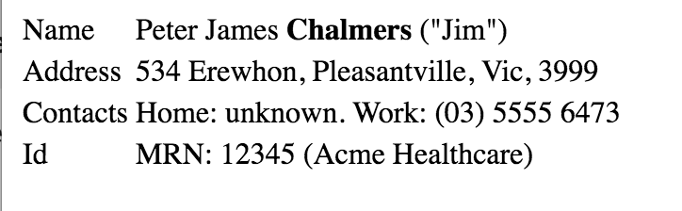

Slide 30
Exercise 1

Slide 31
Exercise 1
Identify the FMM (maturity model) of the Following resources for R4:
Patient
Condition
Observation
Coverage

Slide 32
Exercise 1: Answer
Identify the FMM (maturity model) of the Following resources for R4: https://hl7.org/fhir/R4/resourcelist.html
Patient: N
Condition: 3
Observation: N
Coverage: 2

Slide 33
Exercise 2

Slide 34
Exercise 2
Find out what resources are available in Millennium’s HL7 FHIR R4 implementation that are not in the DSTU2 implementation.

Slide 35
Exercise 2: Answer
PractitionerRole
CareTeam
BodyStructure
OrganizationAffiliation
MolecularSequence
Task
VerificationResult
Linkage
CatalogEntry
AdverseEvent
Optional: MedicationOrder is no longer available in R4 and now split

Slide 36
Exercise 3

Slide 37
Exercise 3
What search parameters does the Millennium R4 implementation of Patient support? Are there any limitations or considerations?

Slide 38
Exercise 3: Answer
Query by: _id
Query by: identifier
Query by a combination of: identifier, birthdate, name, given, family, address-postalcode, phone, or email
There are others (see next slide)
https://fhir.cerner.com/millennium/r4/base/individuals/patient/#parameters

Slide 39
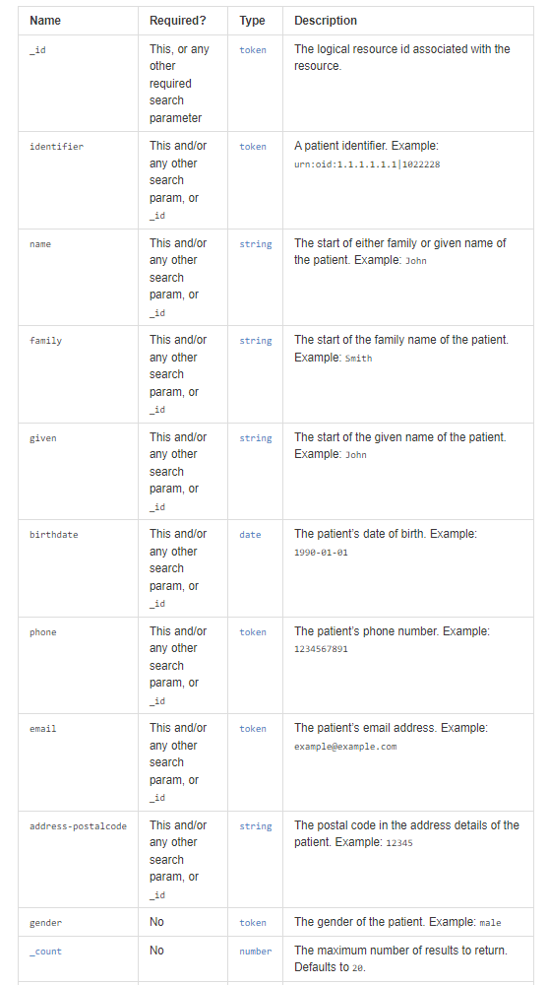

Slide 40
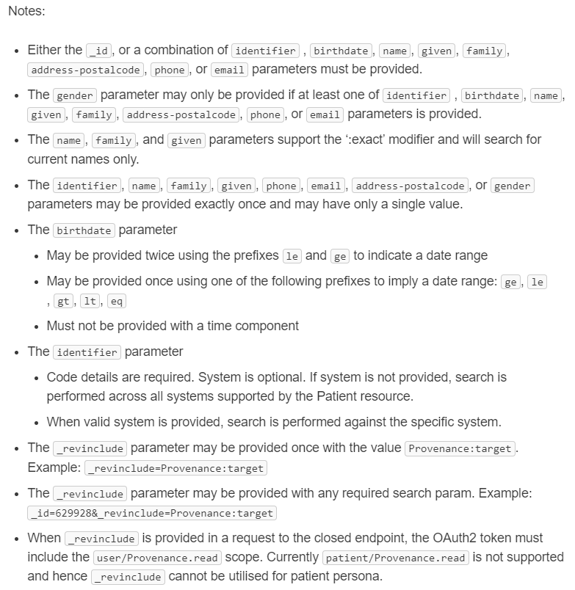

Slide 41
Read

Slide 42
Read
“By ID”
GET [base]/[Resource]/[id]
GET [base]/Patient/123ABC
https://hl7.org/fhir/http.html#read

Slide 43
id vs identifier
id: logical identifier, must be unique within the FHIR server and resource
identifier: business identifier or “alias”
SSN
MRN
Military ID
https://hl7.org/fhir/resource.html#id

Slide 44
Search

Slide 45
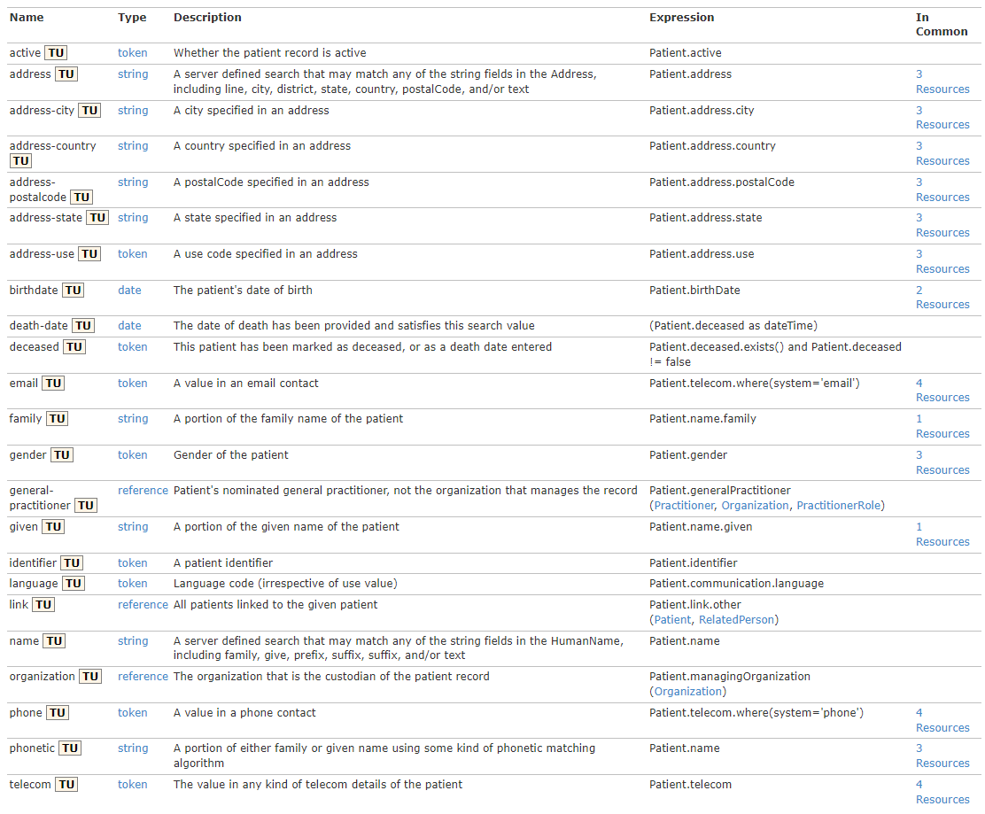
https://hl7.org/fhir/R4/patient.html#search

Slide 46
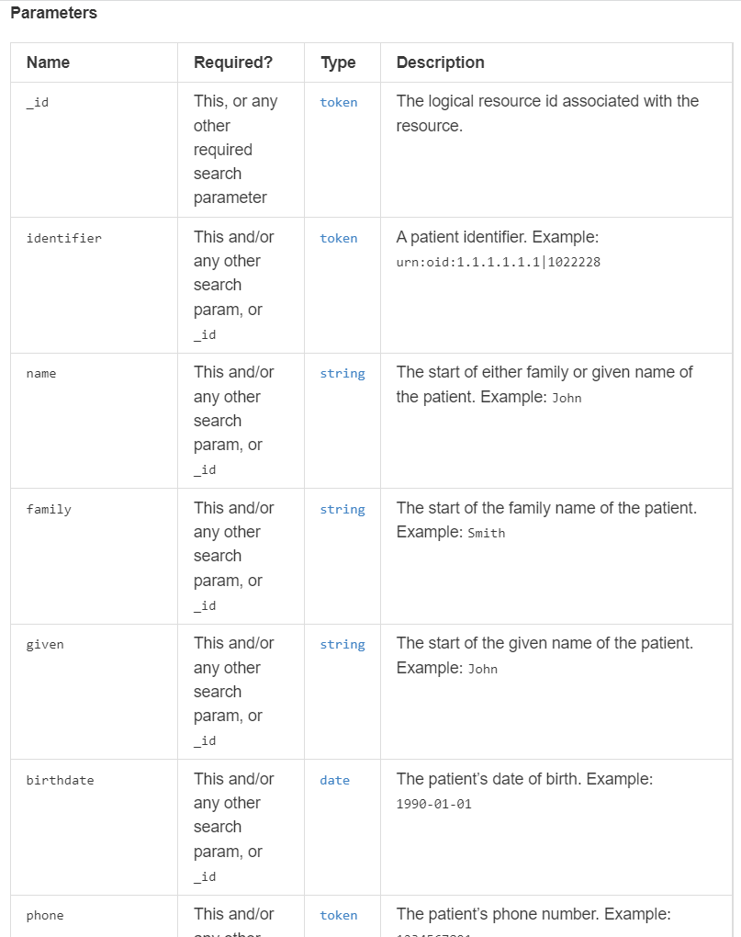
https://fhir.cerner.com/millennium/r4/base/individuals/patient/#parameters

Slide 47
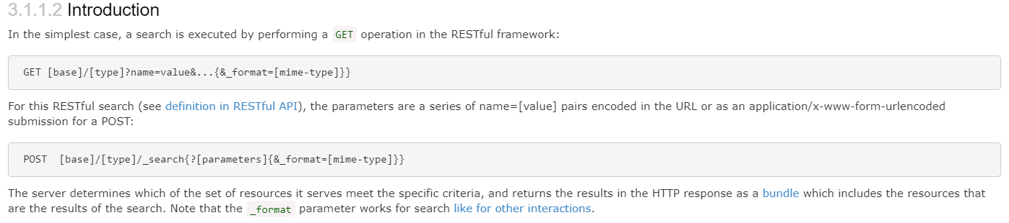
GET [base]/AllergyIntolerance?patient=123
https://hl7.org/fhir/search.html#Introduction
Notes:
This example is searching for all allergies for patient 123

Slide 48
Paging

Slide 49
Paging
Self, First, Previous, Next, Last
Must use link as provided
Changing this has undefined consequences
_count parameter
Less but not more
For interoperability - handle paging
https://hl7.org/fhir/http.html#paging
Notes:
Handle paging in the application, which helps ensure you’re run against most servers. Check for the “next” link to see if there are additional pages.

Slide 50
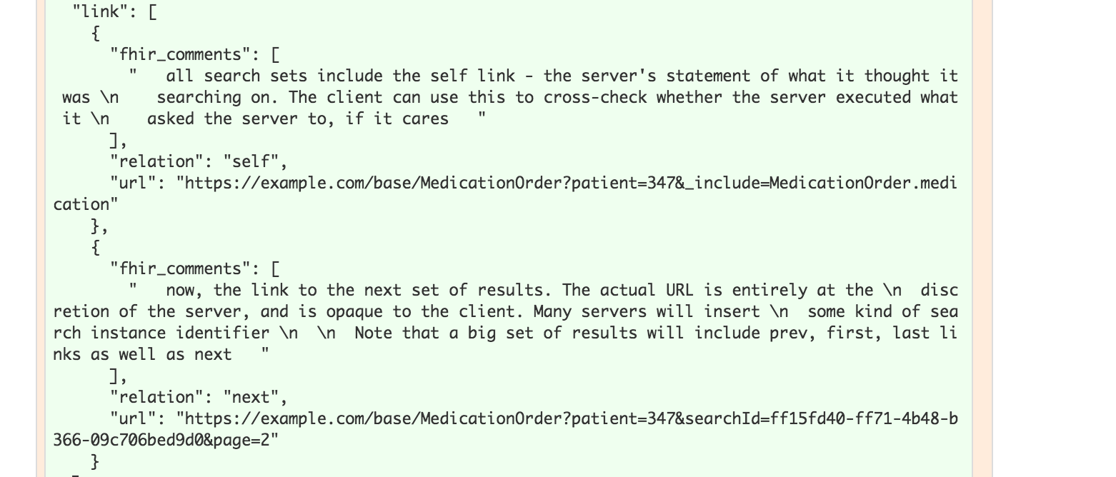

Notes:
The previous link isn’t in this example

Slide 51
Writes

Slide 52
Create
POST [base]/[Resource]
POST [base]/AllergyIntolerance
Body (content-type) must match supported FHIR format
https://hl7.org/fhir/http.html#create

Slide 53
Update
PUT [base]/[Resource]/[id]
PUT [base]/AllergyIntolerance/123
Body (content-type) must match supported FHIR format
https://hl7.org/fhir/http.html#update

Slide 54
Patch
PATCH [base]/[Resource]/[id]
PATCH [base]/AllergyIntolerance/123
Body (content-type) must match supported FHIR format
https://hl7.org/fhir/http.html#patch

Slide 55
Conditional Update
Optimistic Locking via “If-Match”
Example: Version in database: 2a
Version in “If-Match”: 1a - failure
Version in “If-Match”: 2a - success
https://hl7.org/fhir/http.html#transaction

Slide 56
Exercise 4

Slide 57
Exercise 4
Find out the full name for Nancy Smart (id = 12724066)

Slide 58
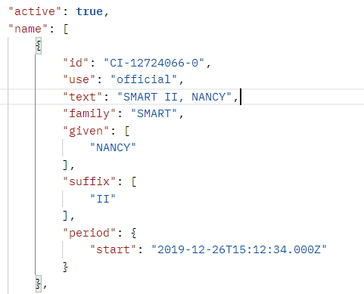
Exercise 4: Answer
Answer: Smart II, Nancy
GET https://fhir-open.cerner.com/r4/ec2458f2-1e24-41c8-b71b-0e701af7583d/Patient/12724066?_format=json
https://hl7.org/fhir/datatypes.html#HumanName (middle is subsequent given name)
Notes:
Note: Patient vs Person. Person represents people “in the real world” for example, it could link to your patient record in many FHIR servers. In CommonWell, most of the core is the “Person” and the records they’re tied to are Patient. We would use Patient here since we’re looking at patient records in an EHR.

Slide 59
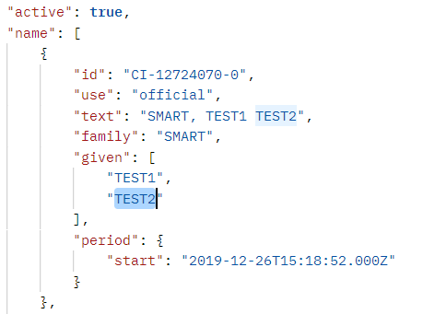
Exercise 4: Answer
Middle Name Example
https://hl7.org/fhir/datatypes.html#HumanName (middle is subsequent given name)
Notes:
Note: Patient vs Person. Person represents people “in the real world” for example, it could link to your patient record in many FHIR servers. In CommonWell, most of the core is the “Person” and the records they’re tied to are Patient. We would use Patient here since we’re looking at patient records in an EHR.

Slide 60
Exercise 5

Slide 61
Exercise 5
How many current allergies or intolerances does Sandy Smart (id = 12742399) have?
Current: actual or possible existing allergies or intolerances
Hint: What indicates “current” for this FHIR resource?

Slide 62
Exercise 5: Answer
24
GET https://fhir-open.cerner.com/r4/ec2458f2-1e24-41c8-b71b-0e701af7583d/AllergyIntolerance?clinical-status=active&patient=12742399&_format=json
Notes:
Note: AllergyIntolerance/123 is looking up an Allergy by its id (not a patient id). Similarly, AllergyIntolerance?_id=123 is looking up allergy by id, not by the patient id.

Slide 63
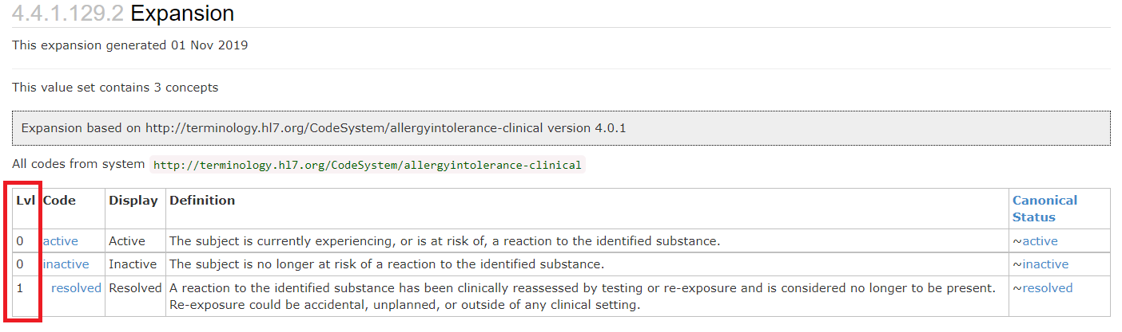
https://hl7.org/fhir/r4/valueset-allergyintolerance-clinical.html#expansion

Slide 64
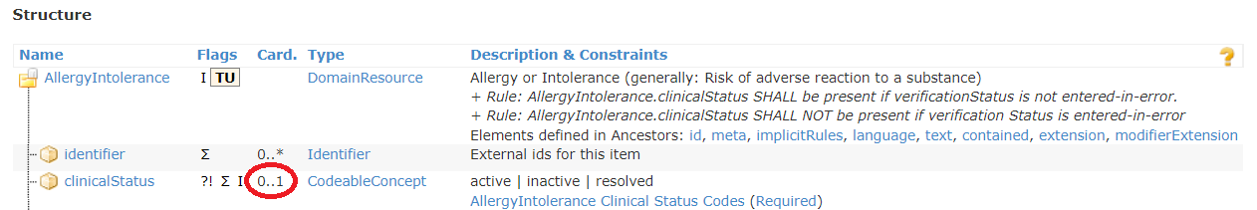
What if it wasn’t mapped/known?
https://hl7.org/fhir/allergyintolerance.html#resource
Notes:
Be aware that querying by a field that isn’t required may mean that values that weren’t mapped or understood by the FHIR server won’t be returned.
In the Allergy case, STU 3 is addressing this issue with allergies by requiring the status and adding an “unknown” that could be used to ensure all possible allergies can be retrieved.

Slide 65
Exercise 6

Slide 66
Exercise 6
How many different medication orders of Sertraline does Fredrick Smart (id = 12724070) have?

Slide 67
Exercise 6: Answer
1
GET https://fhir-open.cerner.com/r4/ec2458f2-1e24-41c8-b71b-0e701af7583d/MedicationRequest?patient=12724070&status=active&_format=json
GET https://fhir-open.cerner.com/r4/ec2458f2-1e24-41c8-b71b-0e701af7583d/MedicationRequest?patient=12724070&status=active&-pageContext=T3BlblBsYXRmb3JtRmhpckNvbnRleHQ9dHJ1ZSZwYWdlQ29udGV4dD0zNjgwNjU0MDhfMzY4MDY1NDE1XzEyNzI0MDcwXzFfMSZjb25jZXB0PWNoYXJ0ZWQ%3D&-pageDirection=NEXT&_format=json

Slide 68
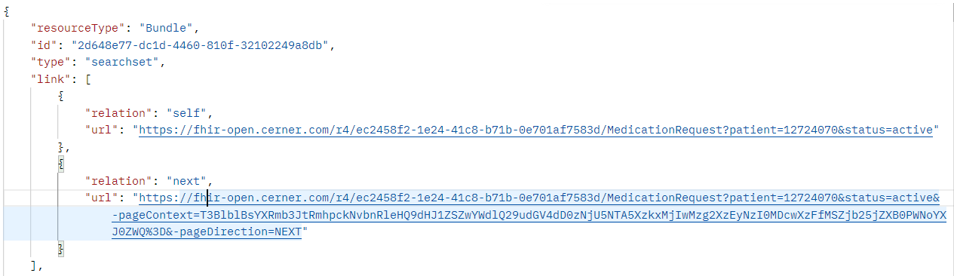
Paging
GET https://fhir-open.cerner.com/r4/ec2458f2-1e24-41c8-b71b-0e701af7583d/MedicationRequest?patient=12724070&status=active&-pageContext=T3BlblBsYXRmb3JtRmhpckNvbnRleHQ9dHJ1ZSZwYWdlQ29udGV4dD0zNjgwNjU0MDhfMzY4MDY1NDE1XzEyNzI0MDcwXzFfMSZjb25jZXB0PWNoYXJ0ZWQ%3D&-pageDirection=NEXT&_format=json
Added _format parameter

Slide 69
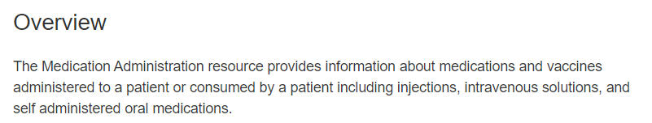
MedicationAdministration?
Could have, though question said order.
https://fhir.cerner.com/millennium/r4/clinical/medications/medication-administration/#overview

Slide 70
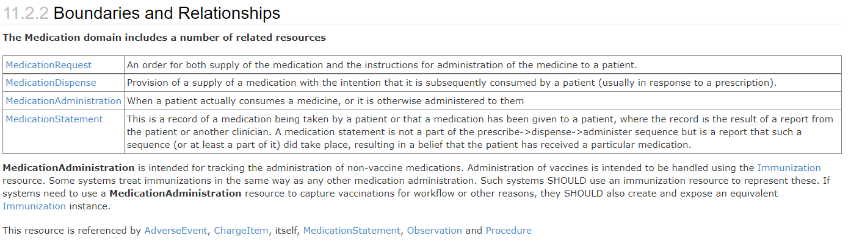
http://hl7.org/fhir/medicationadministration.html#bnr

Slide 71
Exercise 7

Slide 72
Exercise 7
What is the name of the patient with CMRN 171
Hint: the system oid is urn:oid:2.16.840.1.113883.3.787.0.0

Slide 73
Exercise 7: Answer
Smart, Nancy
GET https://fhir-open.cerner.com/r4/ec2458f2-1e24-41c8-b71b-0e701af7583d/Patient?identifier=urn:oid:2.16.840.1.113883.3.787.0.0|171&_format=json

Slide 74
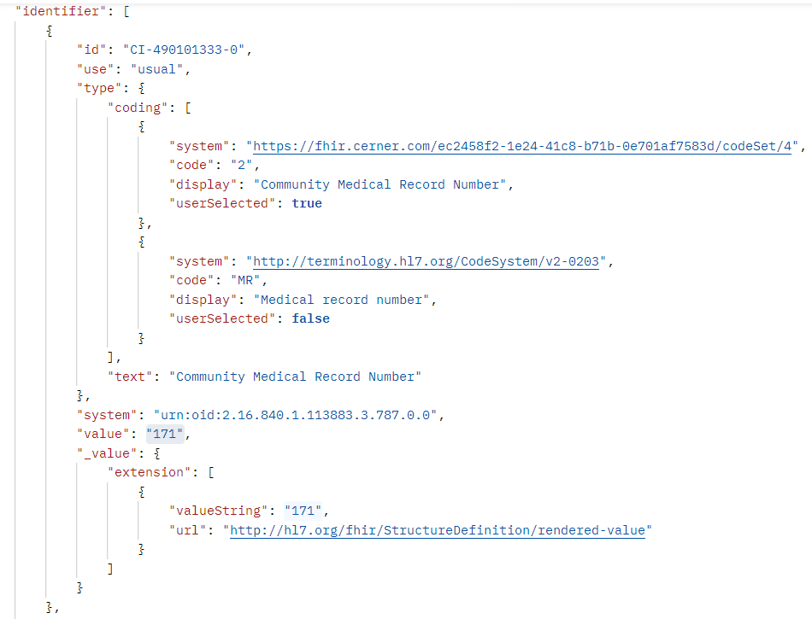
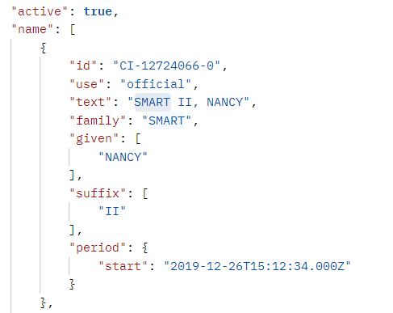

Slide 75
Extensions

Slide 76
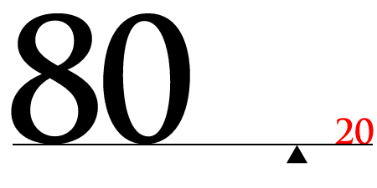
https://hl7.org/fhir/extensibility.html

Slide 77
Extension “Rules”
They’re Expected
They can nest
Server/Client cannot reject because of extension
Unless it’s a modifier

Slide 78
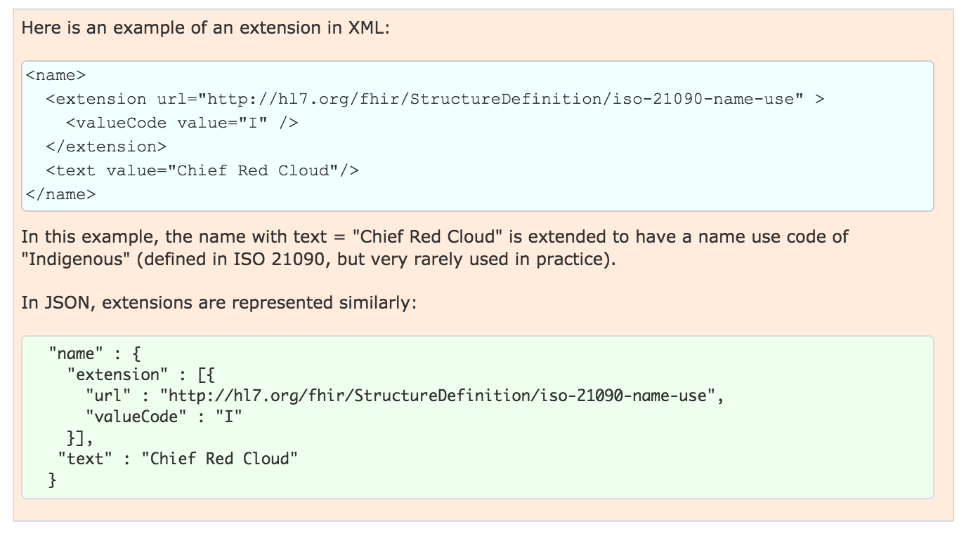
Examples

Slide 79
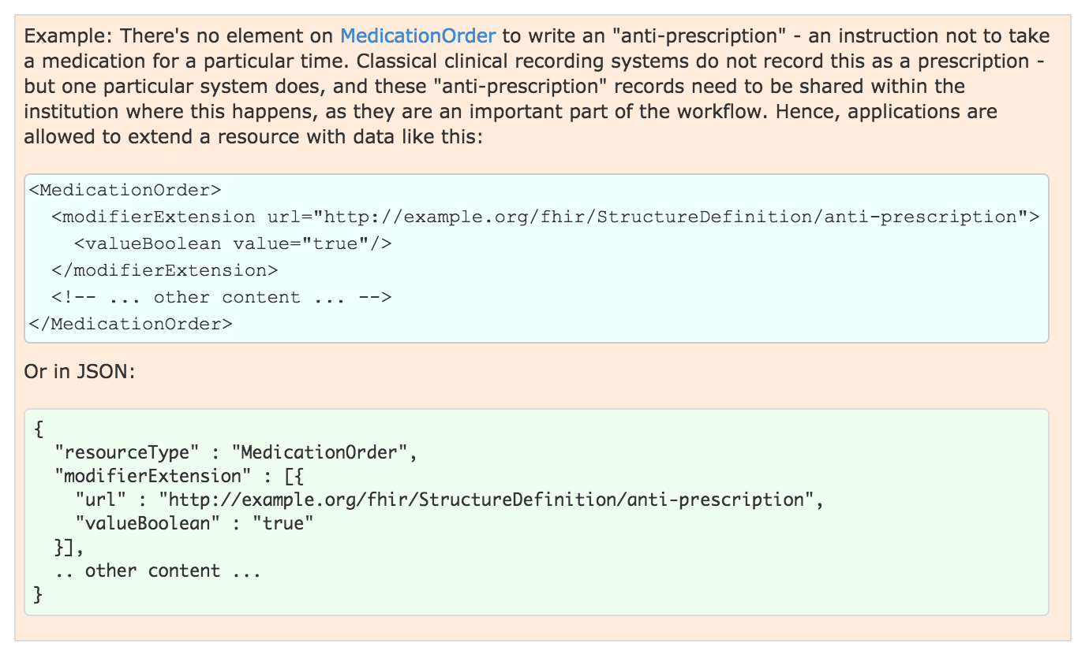
Modifier Example
Notes:
Note: this should show in the narrative

Slide 80
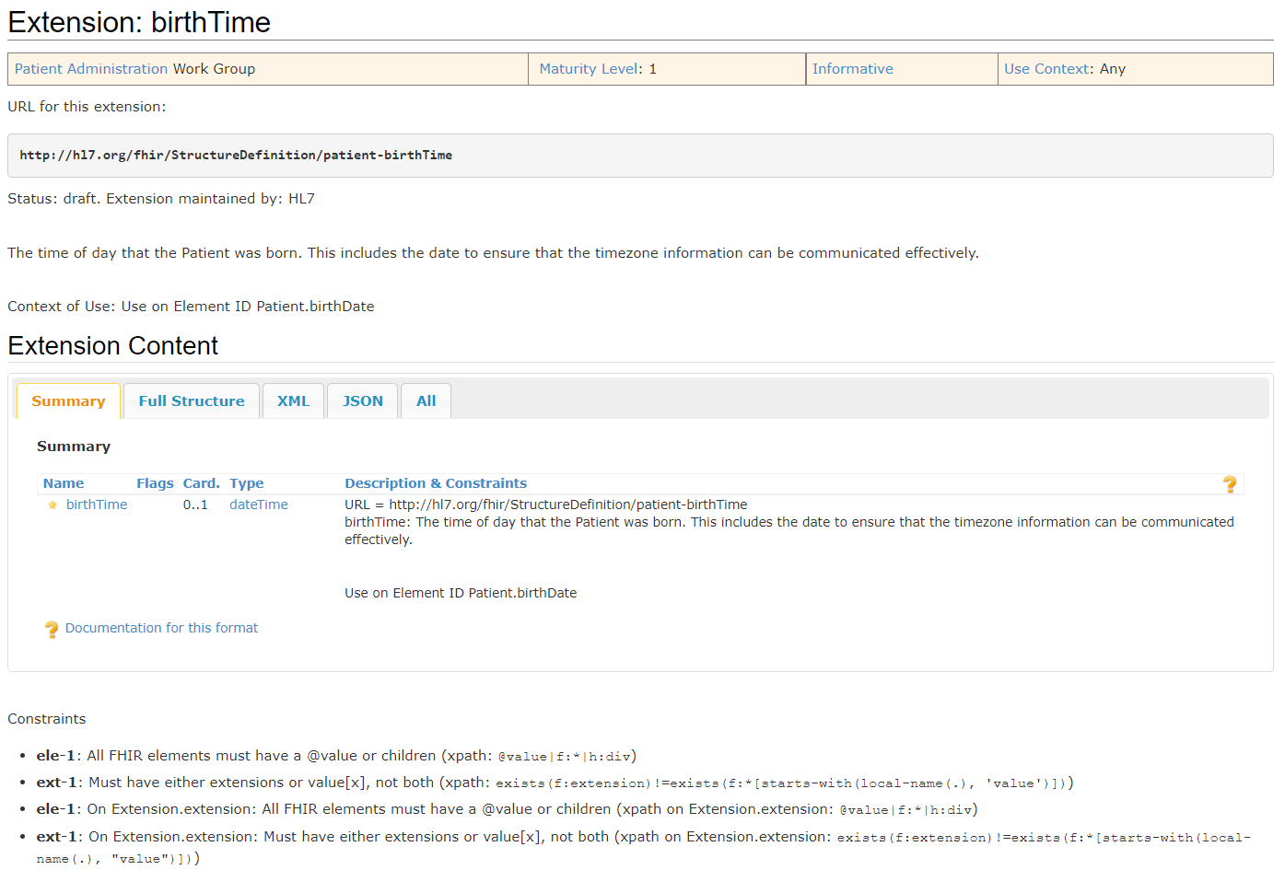
https://hl7.org/fhir/R4/extension-patient-birthtime.html
Notes:
Not a modifier
Extension to patient.birthDate

Slide 81
Conformance

Slide 82
Conformance Resource
Weird: located at [base]/Conformance [base]/metadata
Describes the Server
Step towards auto-config
http://hl7.org/fhir/conformance-rules.html
Notes:
Can be used to describe other things, like desired implementations or capabilities, we’ll concentrate on describing a FHIR server contract.
Not enough to completely configure, but a step in that direction

Slide 83

What?
Which operations?
Which parameters?
Which formats?
Profiles…
Notes:
It defines a large part of the contract

Slide 84
Exercise 8

Slide 85
Exercise 8
Which extensions are supported by the Millennium R4 Patient resource?

Slide 86
Exercise 8: Answer
Patient Birth Time
Patient Preferred Contact
US Core Race
US Core Ethnicity
US Core Birth Sex
Communication Preference
https://fhir.cerner.com/millennium/r4/base/individuals/patient/#extensions

Slide 87
Exercise 9

Slide 88
Exercise 9
According to the Conformance statement, does this FHIR server support OAuth? https://fhir-open.cerner.com/r4/ec2458f2-1e24-41c8-b71b-0e701af7583d/
Notes:
Note: Make sure to remove spaces in your URL for FHIR - there should be none, and having spaces in the server URL will cause errors. HTTP URLs are space and case sensitive.

Slide 89
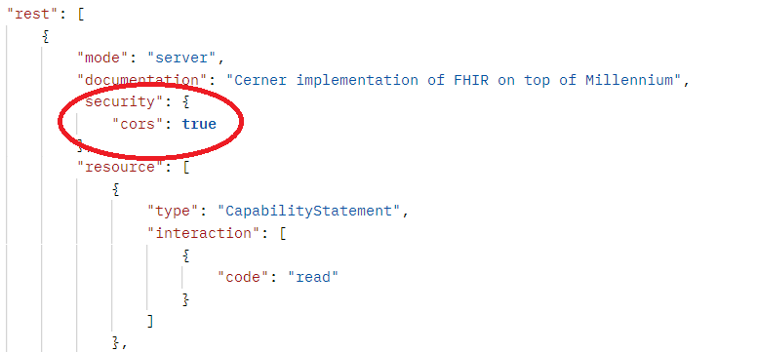
Exercise 9: Answer
Answer: No (it’s our open endpoint)
GET https://fhir-open.cerner.com/r4/ec2458f2-1e24-41c8-b71b-0e701af7583d/metadata?_format=json

Slide 90
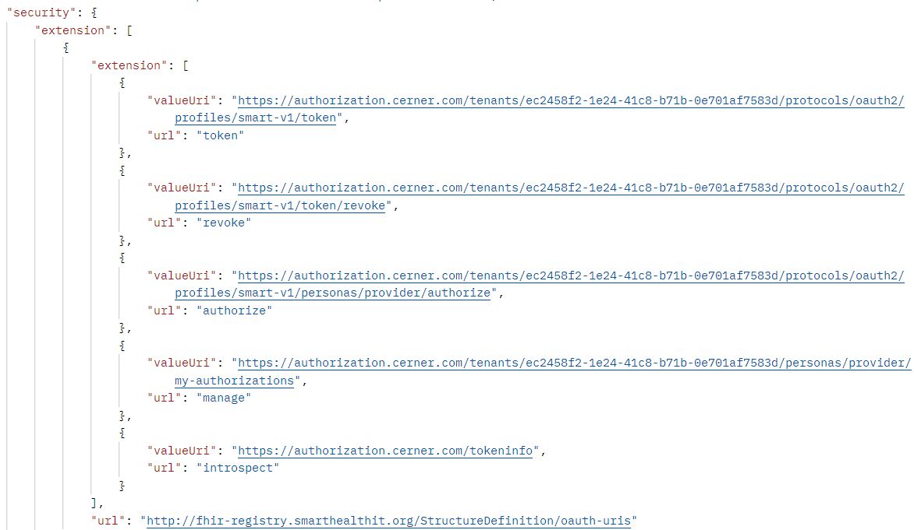
GET https://fhir-ehr.cerner.com/r4/ec2458f2-1e24-41c8-b71b-0e701af7583d/metadata?_format=json
http://hl7.org/fhir/conformance-rules.html

Slide 91
Profiles

Slide 92
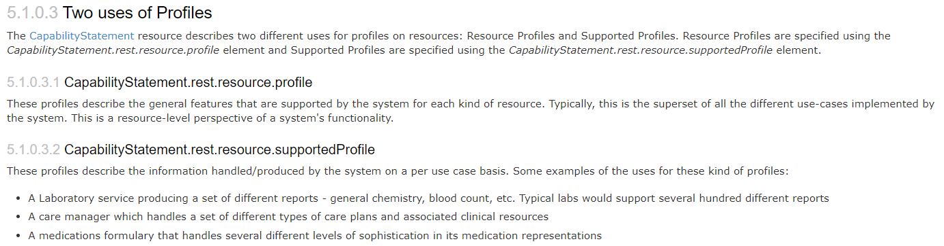
What
https://hl7.org/fhir/profiling.html
Notes:
StructureDefinition resource (in DSTU 2)
Detailed description of contracts, per user case or per system

Slide 93
Rules
Detailed contract
Parameters, operations, api calls
Fields, cardinality
Terminology binding, extensions
Must be compatible with core
Can’t change required binding
Cardinality can restrict more (1..* to 1..1 but not 0..*)
Can’t rename fields
Notes:
Compatible: If core binds as required, you can’t change it
If core has 1..*, you can’t change to 0..*, but can change to 1..1
Goal: must be safe to process a resource without the profile

Slide 94
Questions?

Slide 95
More Exercises!

Slide 96
Exercise 10

Slide 97
Exercise 10
Does Fredrick Smart (id = 12724070) have a normal blood pressure?
Hint: LOINC 85354-9 can be used to find blood pressures

Slide 98
Exercise 10: Answer
It’s normal (120/80)
GET https://fhir-open.cerner.com/r4/ec2458f2-1e24-41c8-b71b-0e701af7583d/Observation?patient=12724070&code=http://loinc.org|85354-9&_format=json(code: http://loinc.org|85354-9)
Notes:
You need to ensure you properly escape/encode the URL so that protected characters are percent encoded. This is to ensure that the server can interpret the URL correctly. Postman does this for you, and *some* http libraries will, but make sure your code (or app) handles this logic to encode or decode as needed.

Slide 99
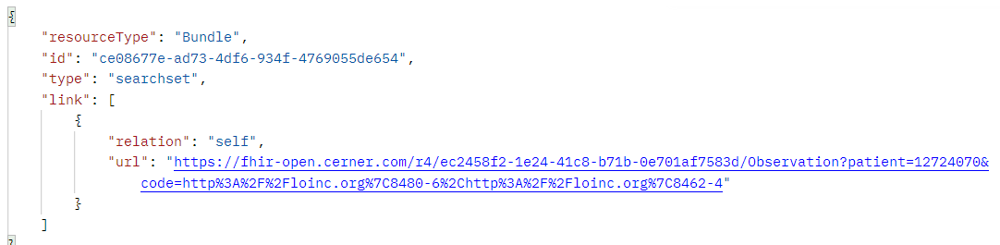
Exercise 10: Answer
Cannot use individual codes for blood pressure like we could in DSTU 2.
GET https://fhir-open.cerner.com/r4/ec2458f2-1e24-41c8-b71b-0e701af7583d/Observation?patient=12724070&code=http://loinc.org|8480-6,http://loinc.org|8462-4&_format=json
Notes:
You need to ensure you properly escape/encode the URL so that protected characters are percent encoded. This is to ensure that the server can interpret the URL correctly. Postman does this for you, and *some* http libraries will, but make sure your code (or app) handles this logic to encode or decode as needed.

Slide 100
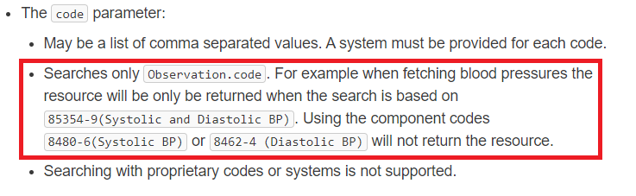
https://fhir.cerner.com/millennium/r4/clinical/diagnostics/observation/#parameters

Slide 101
Exercise 11

Slide 102
Exercise 11
Is Hailey Smart (id = 12724070) currently taking insulin?

Slide 103
Exercise 11: Answer
Answer: No
GET https://fhir-open.cerner.com/r4/ec2458f2-1e24-41c8-b71b-0e701af7583d/MedicationAdministration?patient=12724068&status=in-progress&_format=json

Slide 104
Exercise 12

Slide 105
Exercise 12
Who has a pacemaker: Sandy Smart (id= 12742399) or Nancy Smart (id = 12724066)?

Slide 106
Exercise 12: Answer
Nancy Smart
GET https://fhir-open.cerner.com/r4/ec2458f2-1e24-41c8-b71b-0e701af7583d/Device?patient=12724066&_format=json

Slide 107
Exercise 13

Slide 108
Exercise 13
Who is patient Nancy Smart’s (id = 12724066) child?

Slide 109
Exercise 13: Answer
Answer: Tim Peters, Baby Boy Smart, Sandy Smart, Timmy Smart
GET https://fhir-open.cerner.com/r4/ec2458f2-1e24-41c8-b71b-0e701af7583d/RelatedPerson?patient=12724066&-relationship-level=http://hl7.org/fhir/resource-types|Patient&_format=json

Slide 110
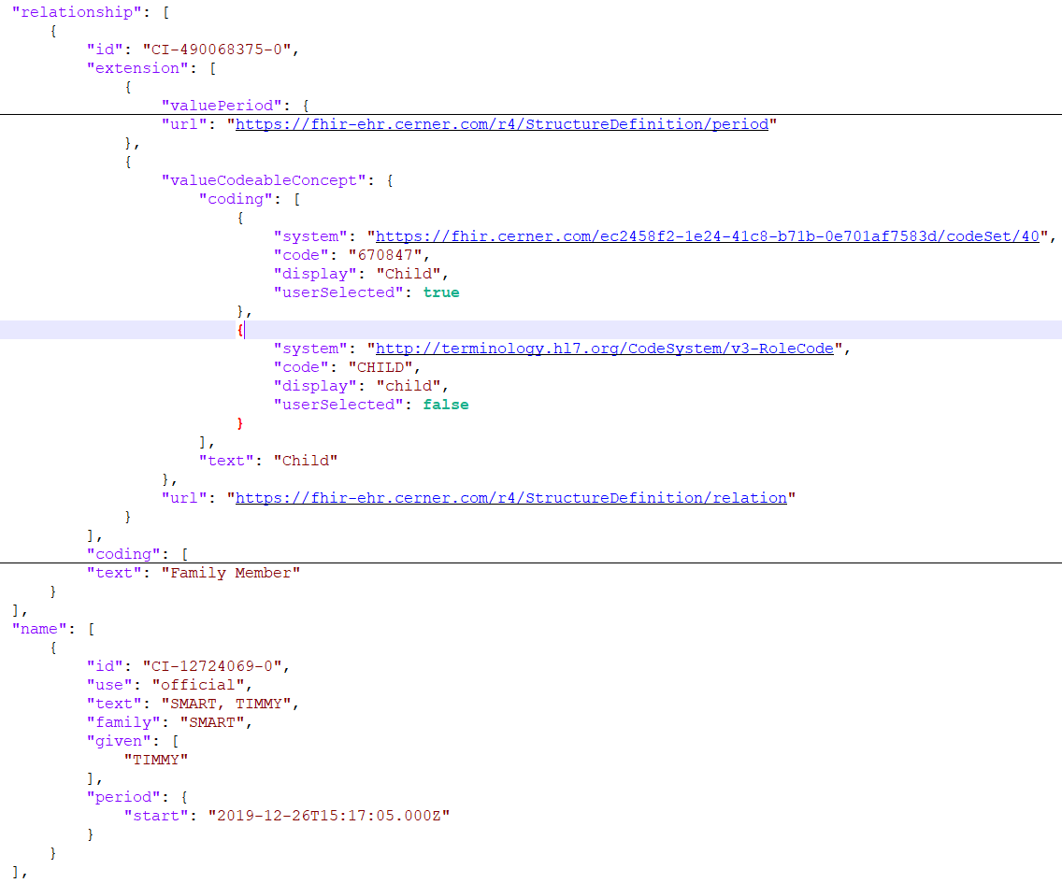

Slide 111
For more test patients
https://docs.google.com/document/d/10RnVyF1etl_17pyCyK96tyhUWRbrTyEcqpwzW-Z-Ybs

Slide 112
Questions?

